Slide 1

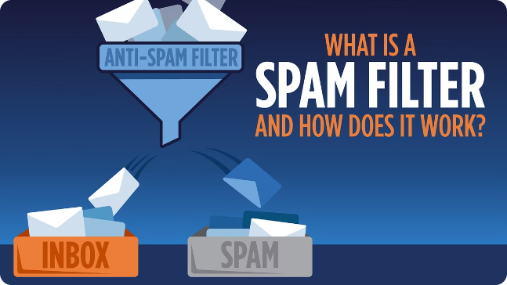
Spam Classification
Spam classification in Natural Language Processing (NLP) represents a critical challenge with practical implications across diverse domains. This project aims to equip students with practical expertise in tackling real-world problems through hands-on application of NLP techniques. By focusing on identifying and filtering out spam messages from legitimate ones, students will delve into essential NLP tasks such as text preprocessing, feature extraction, and model training.
Supervisor:
DR. C. Anitha
Submitted By:
M.Shivani Reddy
192210275

Slide 2
Problem Statement
Pervasive Issue
Threat Mitigation
Advanced Solutions
Spam emails, messages, and other forms of unsolicited communication pose significant challenges in both personal and organizational contexts.
Spam remains a pervasive issue in electronic communications, posing threats ranging from phishing scams to malware distribution and unwanted advertisements.
Current spam filters often rely on rule-based systems or simplistic keyword matching, which can be circumvented by evolving spam tactics and variations in message content. Therefore, there is a pressing need for advanced spam classification systems leveraging Natural Language Processing (NLP) techniques.

Slide 3
Text Classification Techniques
1
Bag-of-Words (Bow) and TF-IDF
2
N-grams
Sequences of n consecutive words extracted from text. Capture local context and phrases that may indicate spammy content (e.g., "get rich quick", "free offer").
Represents each email or message as a vector of word frequencies. TF-IDF weighs the importance of words in each message relative to their frequency across the entire corpus.
3
Word Embeddings
4
Machine Learning Algorithms
Dense vector representations of words capturing semantic meanings. Use pre-trained embeddings or train specific embeddings on a large corpus to understand nuanced language and detect subtle spam patterns beyond simple keywords.
Naive Bayes, Support Vector Machines (SVM), and Ensemble Methods.

Slide 4

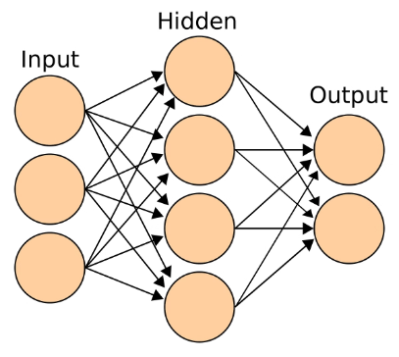
Deep Learning Models
Convolutional Neural Networks (CNNs)
Recurrent Neural Networks (RNNs) and Long Short-Term Memory (LSTM)
Process email content in a hierarchical manner, extracting patterns that indicate spam.
Capture sequential dependencies in email text, useful for detecting sophisticated spam tactics.
Attention Mechanisms
Focus on important words or phrases within emails that are indicative of spam content.

Slide 5
Feature Engineering
Domain-Specific Features
1
Include features like email header information, sender domain analysis, and structural features of emails (e.g., HTML content).
2
Behavioural Features
Analyse user behaviour patterns (e.g., clicking on links, marking emails as spam) to supplement content-based features.
Transfer Learning
3
Adaptation of Pre-trained Models: Fine-tune language models (e.g., BERT, GPT) on spam classification tasks to leverage their understanding of semantic relationships and contextual cues.

Slide 6
Evaluation Metrics
Precision
Recall
F1-score
Receiver Operating Characteristic (ROC) curve
Area Under the Curve (AUC)

Slide 7






Error Identification and Correction
Error Analysis
Conducting thorough analysis of misclassified messages to understand patterns and underlying reasons for classification errors.
Feature Engineering
Enhancing feature extraction methods to capture more nuanced aspects of text data that distinguish between spam and legitimate messages.
Model Evaluation and Selection
Rigorous evaluation of machine learning models using appropriate metrics such as accuracy, precision, recall, and F1-score.
Ensemble Methods
Employing ensemble learning techniques such as bagging, boosting, or stacking to combine multiple classifiers and reduce classification errors.
Error Correction Strategies
Implementing strategies to correct misclassifications in real-time or post-processing.
Continuous Improvement
Establishing mechanisms for continuous monitoring and retraining of the spam classification model.

Slide 8










Data Preprocessing
Data Cleaning
Tokenization
Stop Word Removal
Normalization
Remove HTML tags, special characters, and normalize text.
Split text into individual words or tokens.
Stemming or Lemmatization, and spell correction.
Remove common words that do not carry significant meaning for classification purposes.
Feature Extraction
Handling Imbalanced Data
Data Splitting
Dimensionality Reduction
Training and test sets.
Vectorization and Embeddings.
PCA or feature selection.
Up sampling or down sampling.
Handling Missing Data
Data Encoding
Label encoding.
Imputation.

Slide 9

Conclusion
Classifying spam emails is crucial for maintaining efficient communication and security in digital environments. Through various techniques such as machine learning algorithms, keyword filtering, and heuristic analysis, spam filters can effectively differentiate between legitimate and unwanted emails. These methods have significantly evolved over the years, adapting to increasingly sophisticated spamming techniques.

